Slide 1
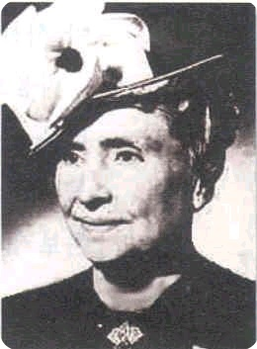
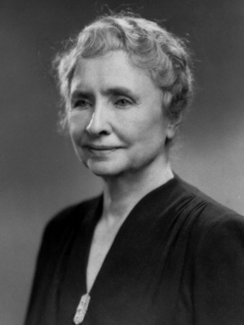
Helen Keller
By: Eliza, Molly, Gracie, and Anna

Slide 2
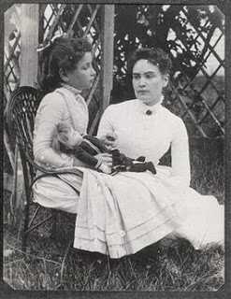
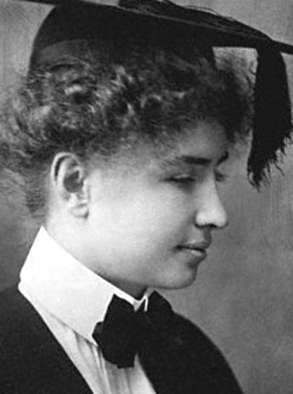
Childhood / Family
born June 1, 1886 in Tuscumbia, Alabama
when Helen was very ill her parents and doctors thought that she would not survive
when Helen Keller was 1 1/2 years old she got extremely ill so she lost both hearing and vision at the age of 18 months
when Helen was 7 years old, finally her parents knew they had to do something so they hired a tutor named Anne Sullivan
she started speaking at the age of 6 months and started to walk at 1 years old
born with the senses of sight and hearing
since Helen was blind it was like a totally different world with different rules
at age 6 Helen mastered braille

Slide 3
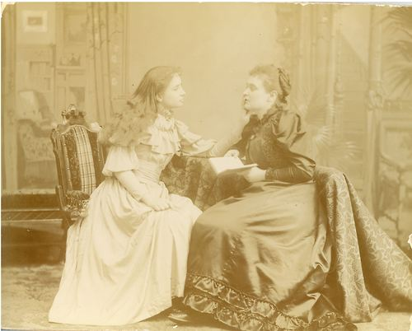
Learning to Communicate
Anne Sullivan helped Helen Keller talk, behave, etc...
Anne put Helen's hand under a water pump and on the other hand Anne spelled W-A-T-E-R
had to identify the water and the letters that Anne spelled on the other hand
also did D-O-L-L, E-A-R-T-H, and a lot more
learned thirty words that day
with the help of Anne Helen learned to read
French and German in braille
in six short months Helen learned 625 words

Slide 4
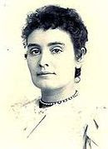
Meeting Anne Sullivan
Anne was very strict, but she had a lot of energy
Anne taught Helen how to spell with her hands
Anne was blind, but then she had to get surgury
she was born April 14, 1866 in Feeding Hills, near Springfield Massachusetts, U.S
Anne was a teacher to Helen when she was 6 years old
Anne worked on an autobiograpy with Helen
Anne came to work with Helen on March 3rd, 1887 and would be her helper for the next 50 years
she died in October 20, 1936 in Forest Hills, New York

Slide 5
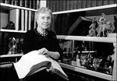
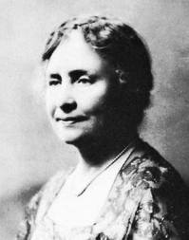
Adulthood/Later years
when Helen was in college she wrote a dozen books
Helen learned to read Greek and Latin in braille
as Helen got older she wanted to help people like her self
she visited 39 countries on five continents
Helen also did research, gave speeches, and helped raise money for many organizations
began a writing career that was to continue
at the age of twenty she entered Radcliff College
she wrote of her life in several books including The Story of My Life
she wrote more than ten books in her life and a lot of articles
she made her last major appearance in 1960 at Washington DC at the Lions Club
died in her sleep on June 1, 1968

Slide 6
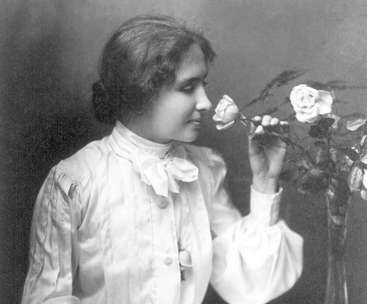
Facts
Helen wrote a book called Teacher about Anne Sullivan's life
she enjoyed animals such as horses, dogs, and chickens
she liked to work in the garden
Anne was often called "The Miracle worker" because she helped Helen a lot
Helen had two older step-brothers and one sister named Katherine Adams Keller

Slide 7
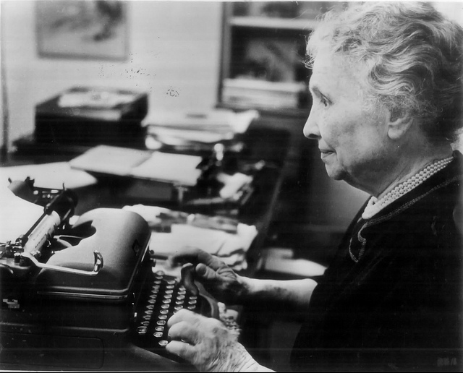
Hard times
at the age of 18 months Helen became blind and deaf from an unknown illness
the doctor said she might not recover
she had a lot of strokes during her life
Helen had no way of knowing that the rest of the family saw, heard, spoke, or that she was any way different from her family and others
most strangers didn't know what she said but she kept trying

Slide 8
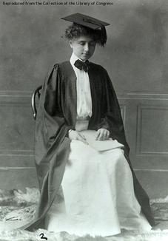
Qualities of a Hero
Brave
Determined
Patient
Perseverance
Optimistic
Kind

