Slide 1
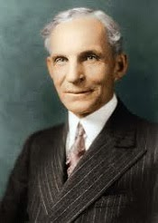
Henry Ford
Connor and Kevin

Slide 2
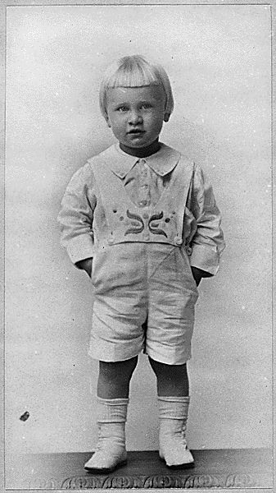
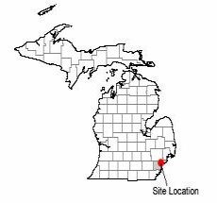
Childhood/Family
Henry Ford is the son of William Ford and Mary Litogot Ford.
Ford was born in Greenfield, Michigan on July 30th,1863.
He worked on his father's farm where he was born.
In 1888 Ford married Clara Bryant.
Ford was very close to his mother, and when he was 13 she died.
He left his home when he was 16.
Dearborn, Michigan

Slide 3
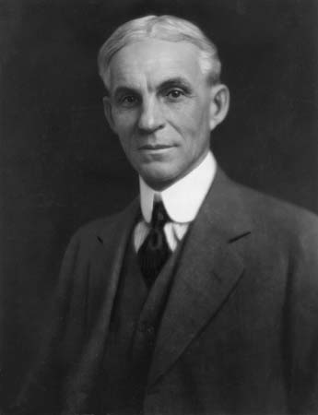
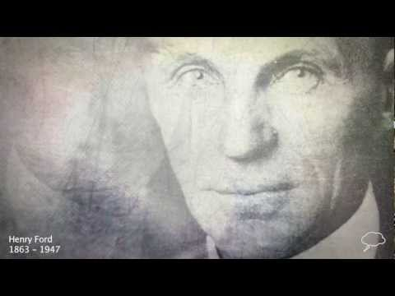
Later Life
eventually Ford returned to Greenfield, Michigan
father gave him 40 acres to start a farm
he died at age 83 of a cerebral hemorrhage

Slide 4
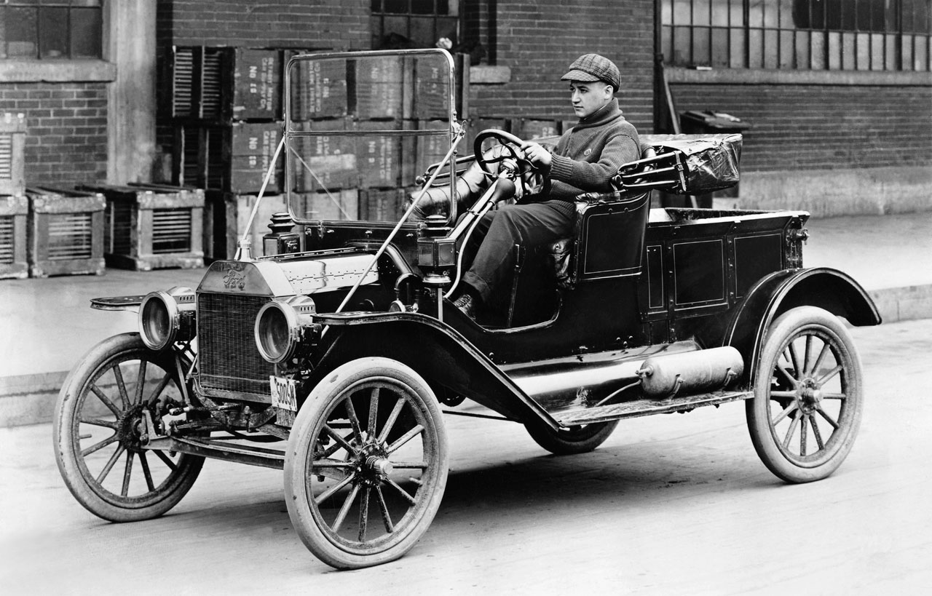
Ford's Cars
Ford used his spare time making petrol driven automobiles
Henry Ford's first car was the Quadricycle
The Model T had a 20 horse power engine and no driver's doors
_

Slide 5
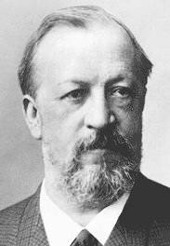
How He Got Inspired
went to the world fair in Chicago where he studied the exhibit of a small petrol engine for pumping water
read about a German engineer Nicholas Otto in a magazine
Nicholas Otto built an internal combustion engine that Henry was interested in
Nicholas Otto

Slide 6
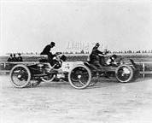
Fun Facts
first car made in little brick shed in his garden (finished in 1896)
first car had no brakes or reverse
made a race car and challenged Alexander Winton, most famous racer to the day
sold the Model T for $850 in 1908
made assembly line and mass produced the model T which decreased the time of making the Model T from 728 min. to 93 min. in 1913
Henry Ford's race

Slide 7
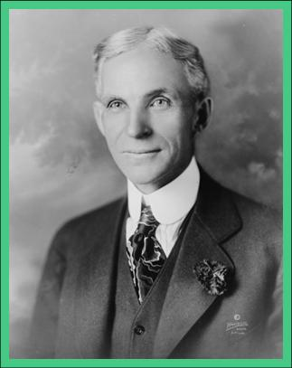
Qualities of a Hero
Heroic
Brave
Mentally strong
Smart
Courageous

