Slide 1
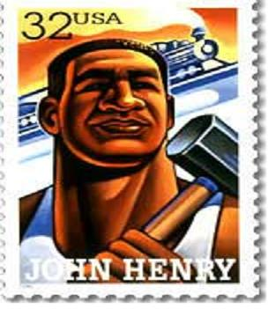
John Henry
By:
Ayden Accola
Dominic Blackburn
Dominic Wiseman

Slide 2
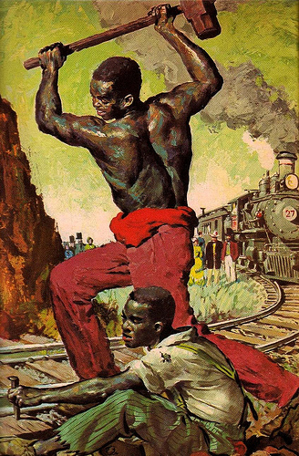
HARDSHIPS
was a slave
more than 6 feet tall and greater than 200 pounds
worked as a steel driver
worked 12 hour days
worked in unsafe conditions
supposedly started working 3 weeks and died while working
was trying to beat a machine
his boss wanted replace the workers with a machine
John henry stopped him by digging more dirt than the machine
John Henry died but the workers weren’t replaced by a machine because of him.

Slide 3
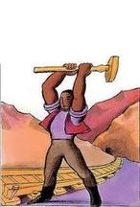
CHILDHOOD/FAMILY LIFE
born a slave
died in his 30’s
had a wife and a baby
born in North Carolina or Virginia (people aren't sure)

Slide 4
Famous For...
More power than a machine
worked as a steel driver
known for "The Ballad of John Henry" and hammer/work songs
illustrations, books, and short films are made about him
symbol for all working men
"Dying ain’t important…. everybody does that, what matters is how well you live."
slaves and people working on railroads
deep voice
banjo player
strongest, fastest, most powerful man working on the railroads

Slide 5
Hold the Fort

Slide 6
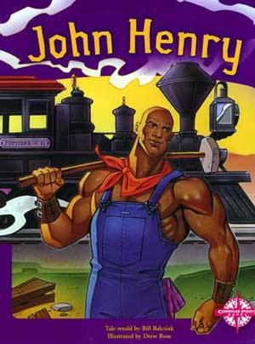
Facts
6 feet tall and 200 pounds
liked to eat
hammered 14 feet
could use two hammers at a time
worked faster than a machine
when he died, other workers sang a song about him which gave them strength and helped others to remember John Henry as the workers hero
told the railroad boss that if he couldn't beat the machine that he would buy it

Slide 7
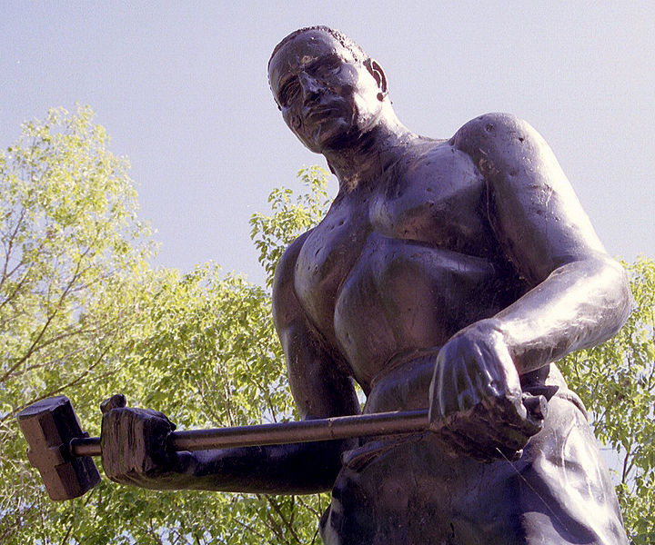
Qualities of a hero
kind
brave
tough
sacrificed his life
smart
helpful

Slide 8
The End

