Slide 1
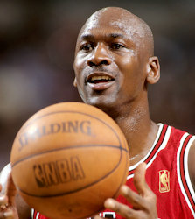
Michael Jordan
By: Harley, Jake, Landon

Slide 2
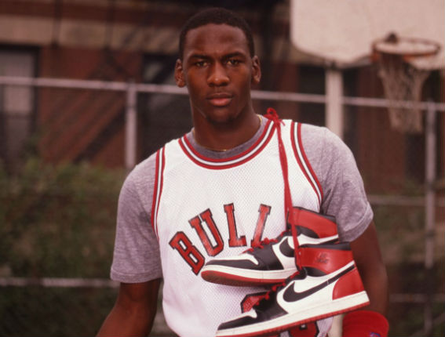
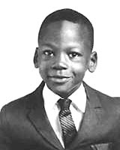
Childhood/Family
Michael Jordan was born in Brooklyn, New York
born on February 17, 1963
raised in Wilmington, North Carolina
went to the University of North Carolina for college
had trouble making his high school team
is a billionaire
won two most valuable player awards
kids’ names are Jasmine, Marcus, Jeffrey, Ysabel, and Victoria

Slide 3
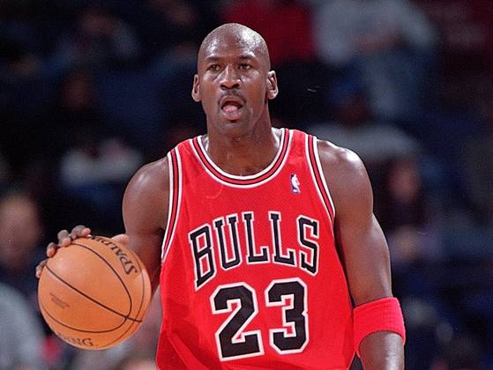
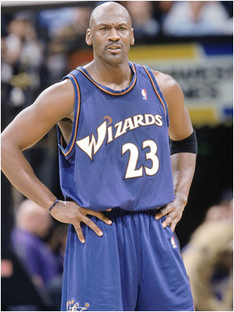
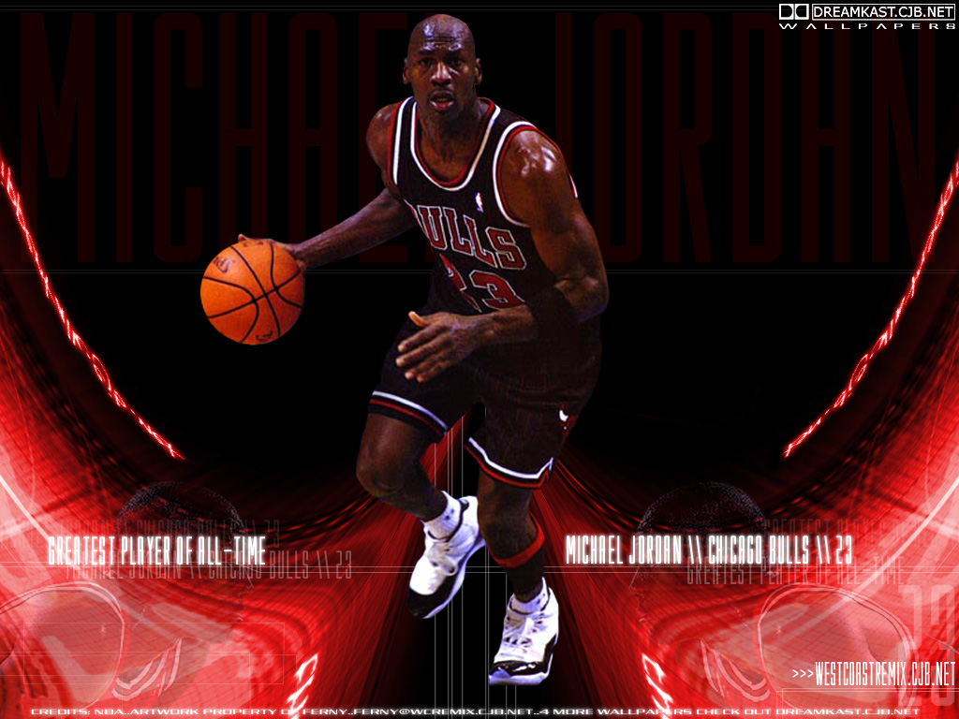
Basketball career
had a great career in basketball
made about 5,000 dunks in his career
won 6 NBA Championship trophies
helped the Chicago Bulls win a lot of games
last played on the Wizards
possibly one of the greatest players of all time

Slide 4
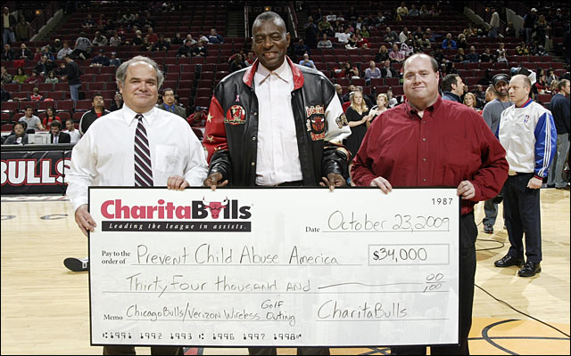
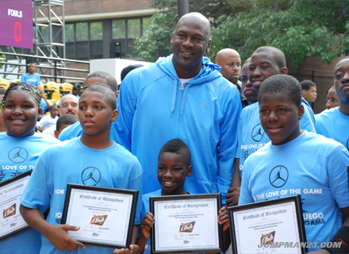
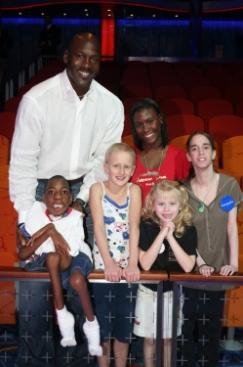
Charities, Events, and Causes
helped 14 charities and has worked for 11 different causes
four charities that he helped are Boy and Girls Clubs of America, Kids Wish Network, the Miami Project, and Make a Wish Foundation

Slide 5
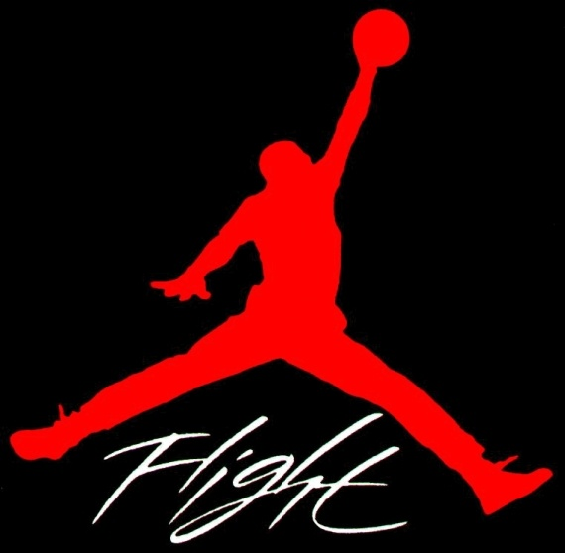
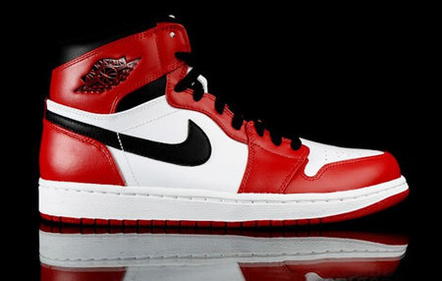
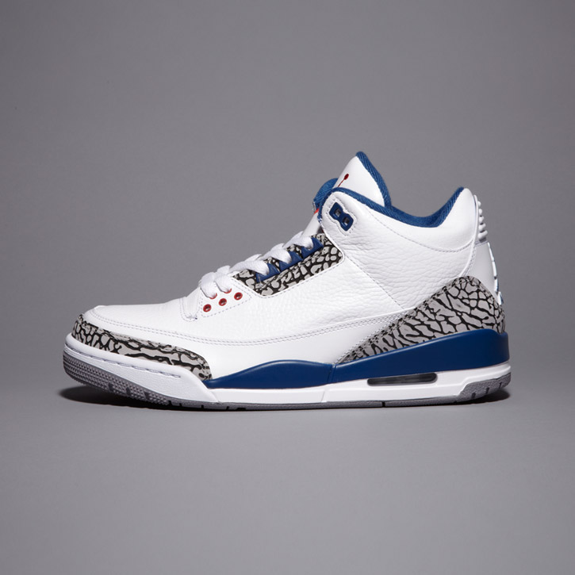
Brand/Products
black/red Air Jordan’s are his most fashionable shoes
logo is Air Jordan
Air Jordan is very popular
He is still the highest paid athlete

Slide 6
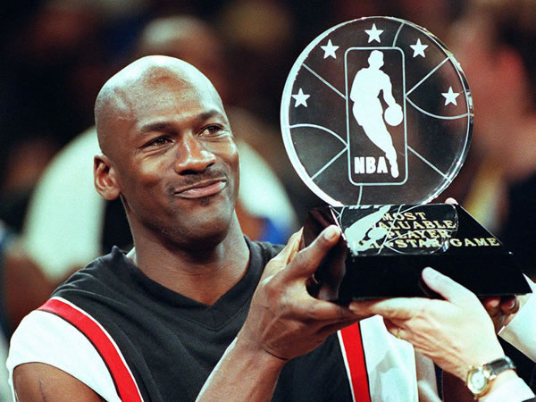
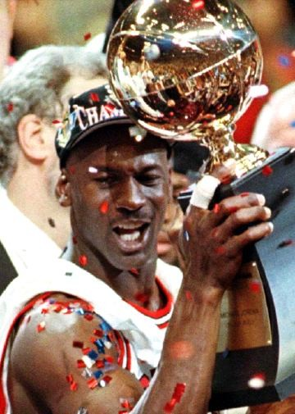
Records
scored 32,292 points his career with the Bulls
was the 1st 40 year old player in the league in 2003
won an Olympic gold medal in 1984 and 1992
won 2 most valuable player awards
won 2 slam dunk titles
won a lot of championships in his career
averaged 31 points per game
was in 13 All-Star leagues

Slide 7
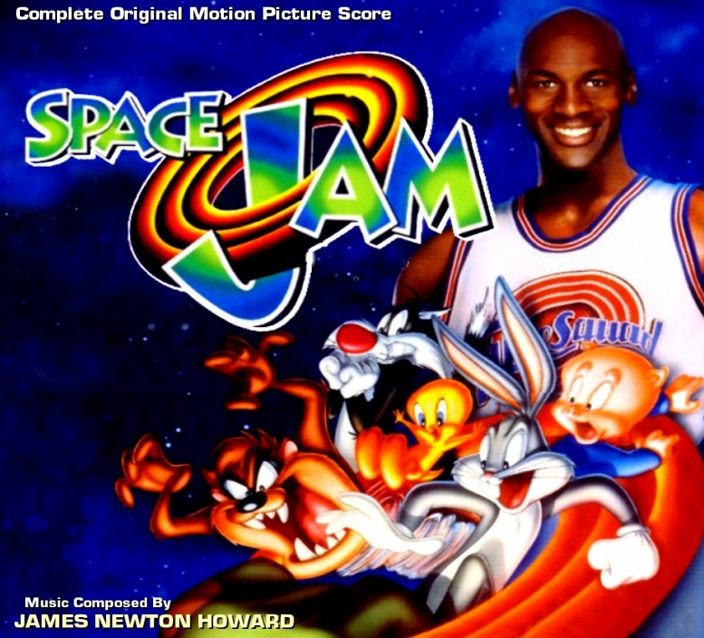
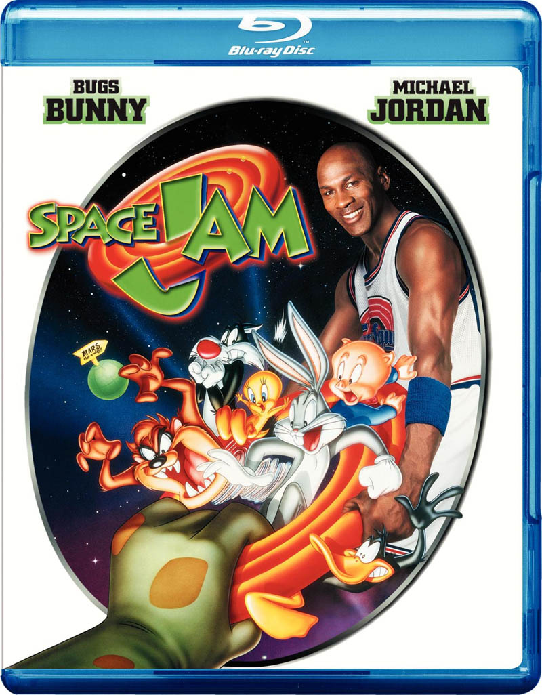
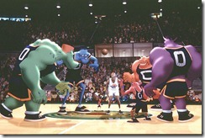
Fun Facts
favorite sport was actually baseball
his brother Larry got Michael into basketball
He played baseball for the Chicago White Sox
Michael Jordan was in the movie Space Jam
He was in video games, too
He owns the Hornets

Slide 8
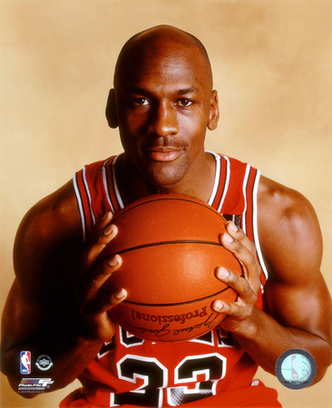
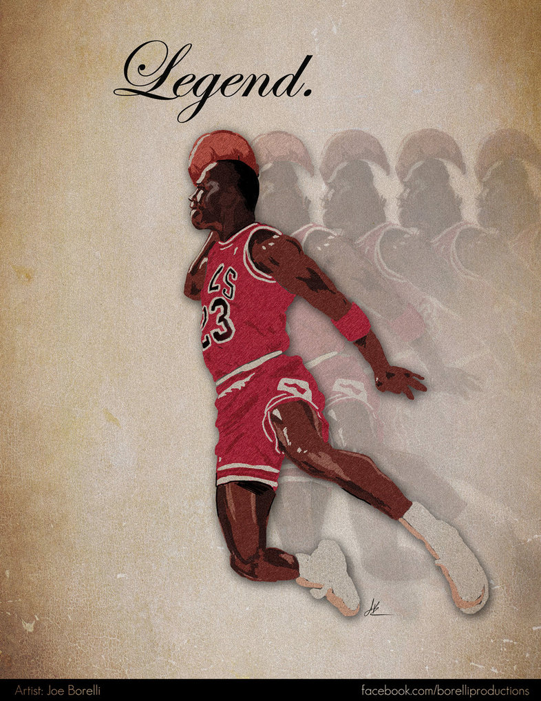
Qualities of a Hero
athletic
role model
brave
successful
pushed himself
perseverance
humanitarian

