Slide 1
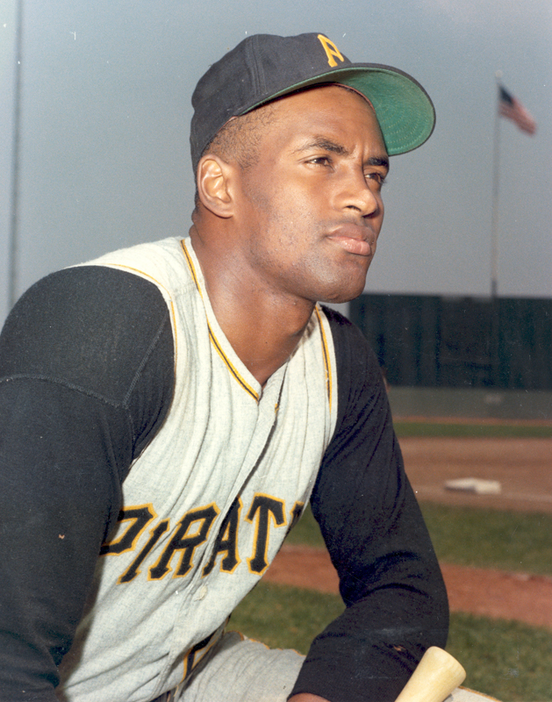
Roberto Clemente
by: Sam, Ben, and Nick

Slide 2
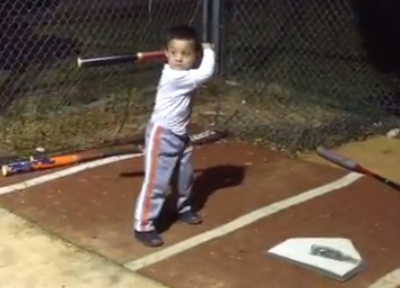
Childhood
Roberto was born in San Juan, Puerto Rico August 18, 1939
dad was a sugar-cane worker
baseball career started right after high school
was the youngest of 7 kids
mom did the laundry, ran a grocery store, and did work at the sugar-cane plantation

Slide 3
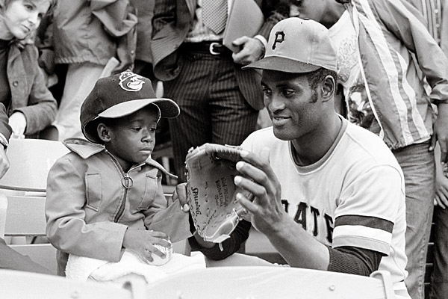
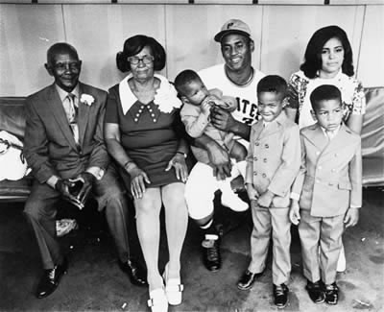
Family
On November 14, 1964 Clemente married Vera Cristina Zabala
Clemente's sons were named Roberto Jr., Roberto Enrique, and Luis Clemente
Clemente's sons were 6, 5, and 2 when their dad died in 1972

Slide 4
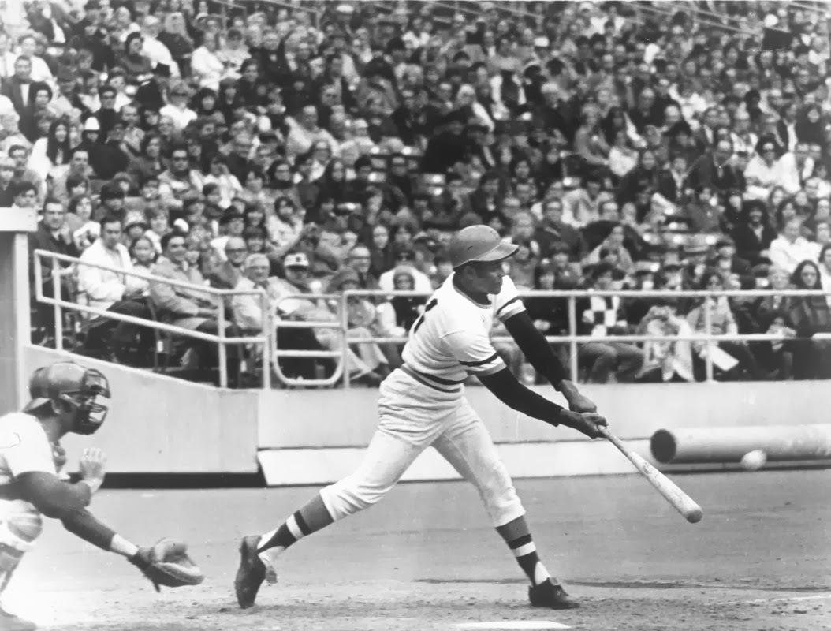
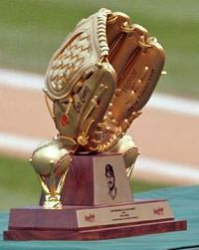
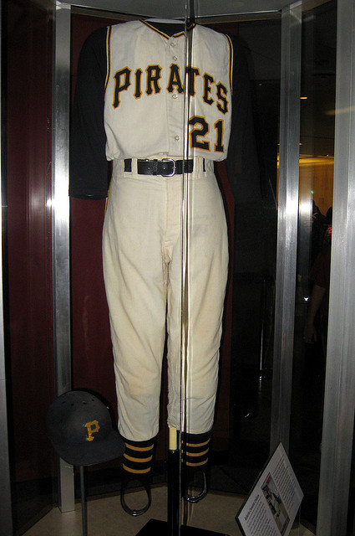
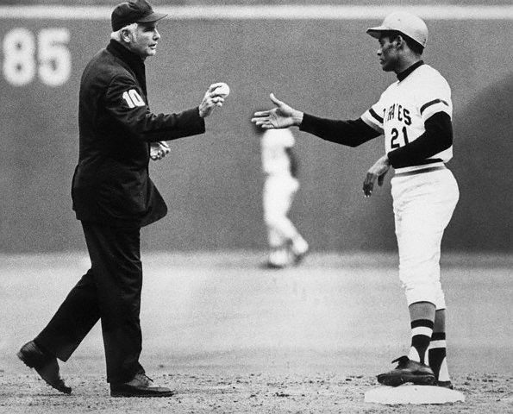
Major League Career
Roberto played on the Crabbers, and as he got older he played on the Pittsburg Pirates, Brooklyn Dodgers
was the 1st Hispanic player to reach 3,000 hits including 240 home runs
he played MLB from 1955-1972
Roberto played baseball in 2 different countries
Clemente was well liked by his teammates
he never let injuries get in the way of playing a good game
won the Golden Glove Award 12 years straight for his impressive work as a right fielder

Slide 5
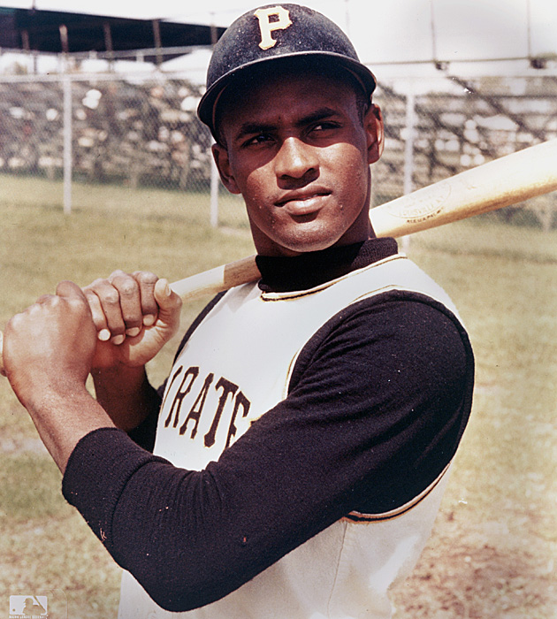
Later Years
Roberto Clemente's greatness made him the diamond
helping others represented the way he lived and the way he died
after he died in 1974 his family built Sports City in Puerto Rico for poor kids
in 2002 he was awarded the Presidential Medal of Freedom
he bought a house for his parents

Slide 6
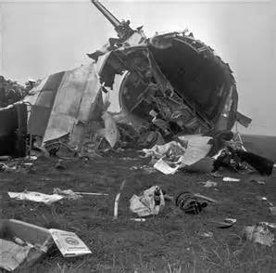
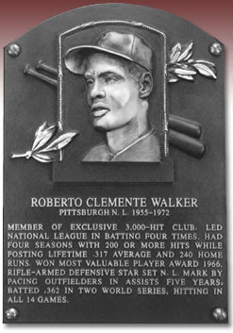
Death
Clemente died on a break from his baseball career at Puerto Rico going to a nearby country hit by an earthquake to help
he went by plane
tragically the plane crashed as it was lifting off
Clemente did not survive
born on August 18, 1939 died on Dec. 31,
died at the age of 38 in 1972

Slide 7
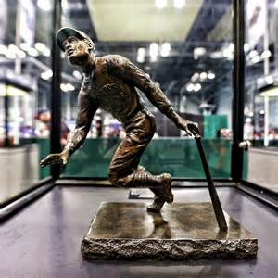
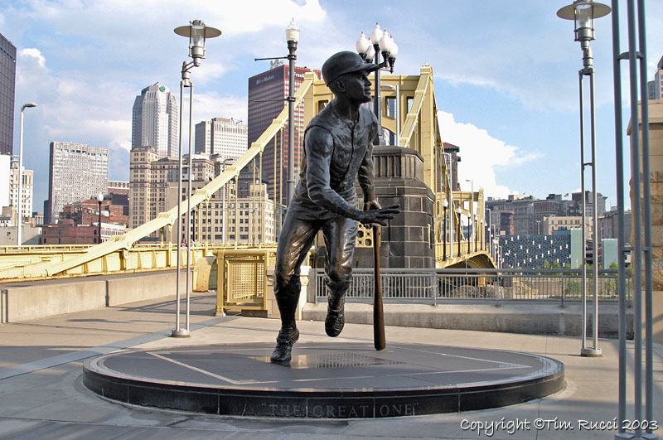
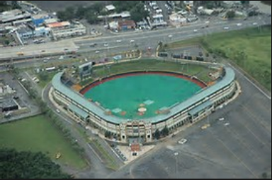
Fun Facts
Roberto broke the color barrier
two of his nicknames were Rob or Sweetness
now Roberto has a statue and an award
real name is Roberto Walker Clemente
some baseball cards would say Bob on them
Roberto named a son after his brother
he joined the U.S. Marine Corps in 1958
he was inducted into the Marine Corps Sports hall of Fame in 2003

Slide 8
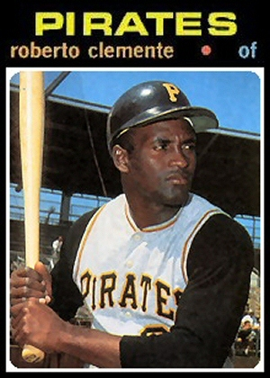
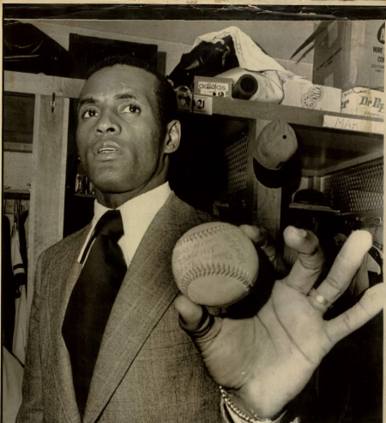
Qualities of a Hero
brave
strong
helpful
smart
leader
courage
empathy
perseverance
amazing

