Slide 1
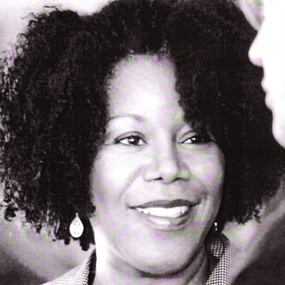
Ruby Bridges
By Amanda, Brooke, and Sanaa

Slide 2
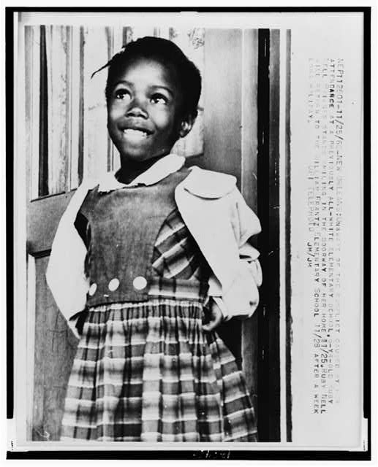
Childhood/Family
born on September 8, 1954
she had two brothers and one sister
her parents are Lucille and Abon Bridges
she moved to Tylertown, Mississippi and to New Orleans, Louisiana
her family worked as sharecroppers
moved for better opportunities

Slide 3
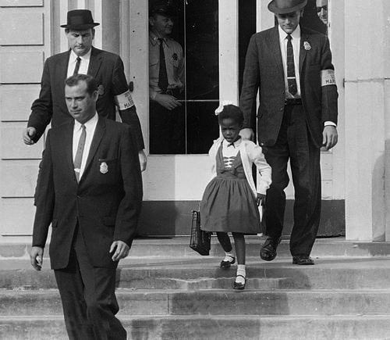
Going to School
African Americans were segregated from white students
She was the only African American student at William Frantz Elementary School
Ruby is the only student in her first grade class (age 6) in 1960
later, Ruby and five other African American girls attended William Frantz Elementary School
she paved the way for other black students going to white schools
sending Ruby to school was going to be the best thing for her

Slide 4
The Ruby Bridges Foundation
created the foundation to help promote racial equality
main focus is to create a school that would set an example for integration and equality in education
mission is to educate leaders committed to social justice, community service, equality, racial healing and nonviolence

Slide 5
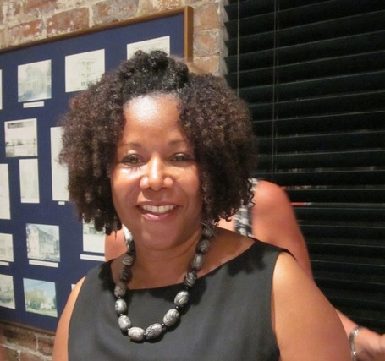
later years civil rights activist
later in life she took care of her brother’s kids
volunteer at their school; school she also attended
her child psychologist published a book about his experience with Ruby and school
because of the book, she went on to talk about all of this with Oprah Winfrey
1999 formed Ruby Bridges Foundation (the foundation’s goal connects parents to schools)

Slide 6
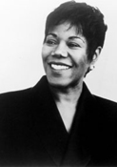
What did Ruby learn from all of this?
she learned you can't judge someone by the color of their skin
none of us know anything about disliking anyone
she was an innocent child and knew nothing about racism

Slide 7
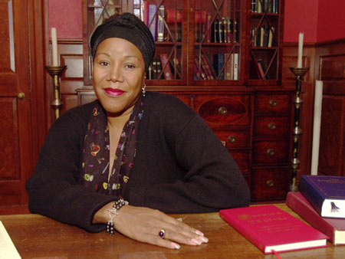
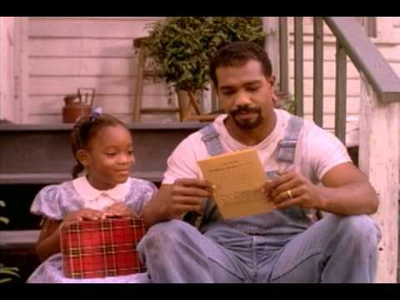
Facts
she was 6 when she started school
they made a story and movie on her life
people shouted "2, 4, 6, 8 ....we don't want to immigrate!" which hurt her feelings
her mom stood up for her when she was sad or crying

Slide 8
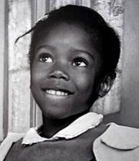
Qualities of a hero
Brave
Inspiration
Kind
Determined
Strong
Helpful

